Slide 1
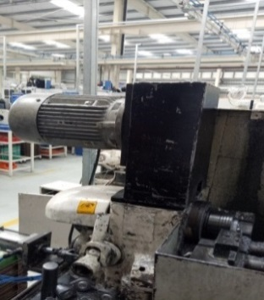
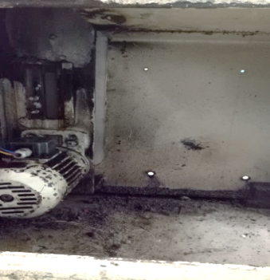
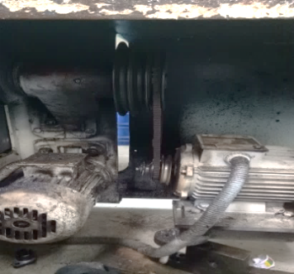
P15
TPM CIRCLE NO :-
ACTIVITY
KK
QM
PM
JH
SHE
OT
DM
E&T
KAIZEN IDEA SHEET
TPM CIRCLE NAME:
LOSS NO. / STEP
DEPT :- Maint.
RESULT AREA
P
Q
A
C
D
S
M
CELL:-
CELL NAME:- Turning
MACHINE / STAGE :- Traub / Spindle motor
OPERATION :- Turning
KAIZEN THEME: To Reduce MTTR
IDEA : To take spindle motor up side of machine
Problem Status :-
1)Difficult to maintenance of spindle motor due to motor mounting inside the m/c body.
2)Various type of motor used for all tragus .
COUNTERMEASURE: Spindle motor taken upper side of machine.
BENCHMARK
90 min
TARGET
30 min
KAIZEN START
5.7.2016
KAIZEN FINISH
20.9.2016
TEAM MEMBERS : Sujit, Bajrang, Sagar
BENEFITS : 1) MTTR Reduced
2)Standardized the motor- Previous
various types of motor used motor
cost is 4500 RS. total machine is 7 no’s
& motor req. in spare.
3)Productivity Increased
Before
After
KAIZEN SUSTENANCE
WHY - WHY ANALYSIS :-
Why1-Difficult to maintenance of spindle motor
Why2-Spindle motor mounting inside the m/c body.
Why3-manufacturing design defect
RESULT :-
WHAT TO DO:- Irreversible
HOW TO DO:-
FREQUENCY :-
MTTR Reduced in Min.
ROOT CAUSE : Manufacturing design defect
SCOPE & PLAN FOR HORIZONTAL DEPLOYMENT
SR.
NO.
CELL
TARGET
RESPONSIBILITY
STATUS
REGISTRATION NO. & DATE : 10.10.2016
1
Traub
6 No’s
10.10.16
Sujit
c
REGISTERED BY :- Sujit
MANAGER’S SIGN :- SNC

